Slide 1

ECE 105: Introduction to Electrical Engineering
Lecture 10
Device 2
Yasser Khan
Rehan Kapadia

Slide 2




Slide 3
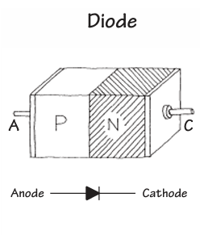
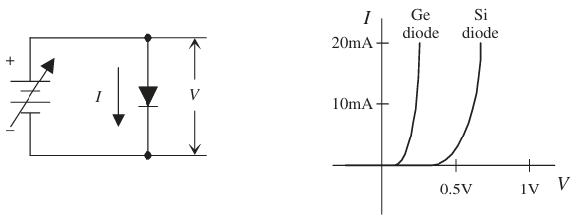


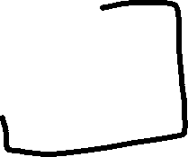


What is a diode
A diode is a device that exhibits ‘rectifying’ behavior
Can be made from a physical junction between an n-type semiconductor and a p-type semiconductor
Can also be made from a physical junction between a metal and semiconductor (not discussed here)

Slide 4











Slide 5
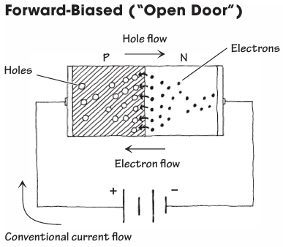
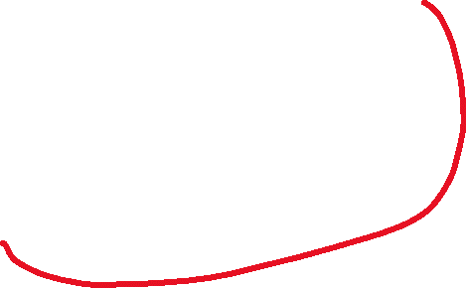
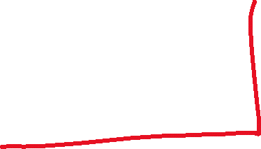
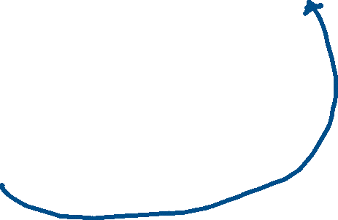


Forward biasing a diode

Slide 6





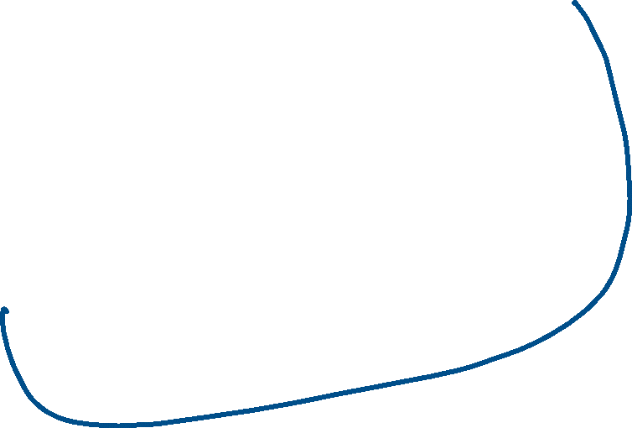










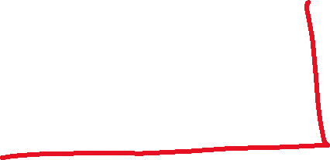

Slide 7
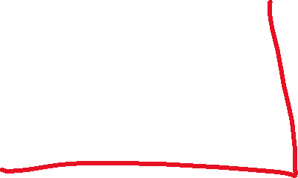



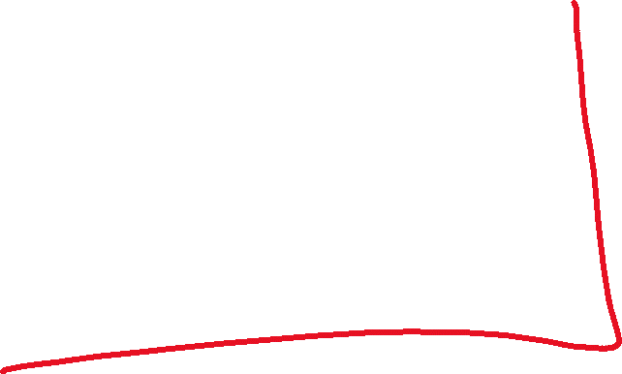











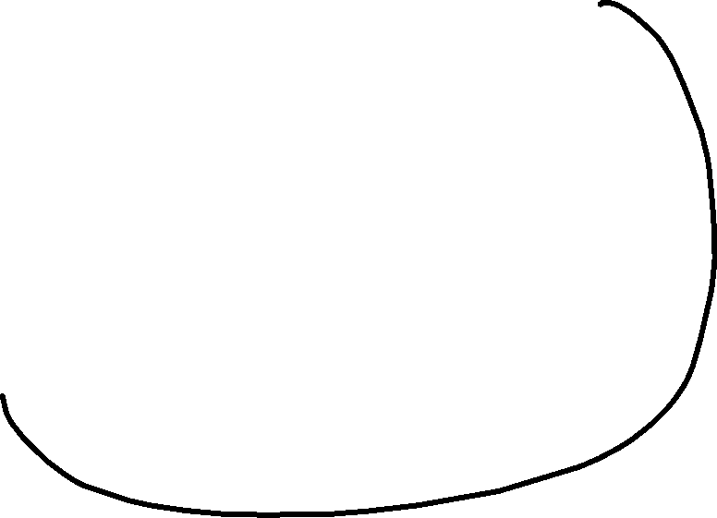












Slide 8




Slide 9
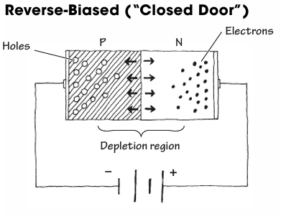
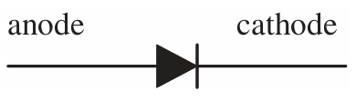






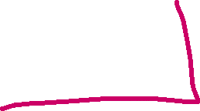

Reverse biasing a diode

Slide 10






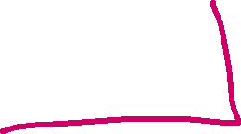

Reverse biasing a diode

Slide 11
Diode characterization

Slide 12
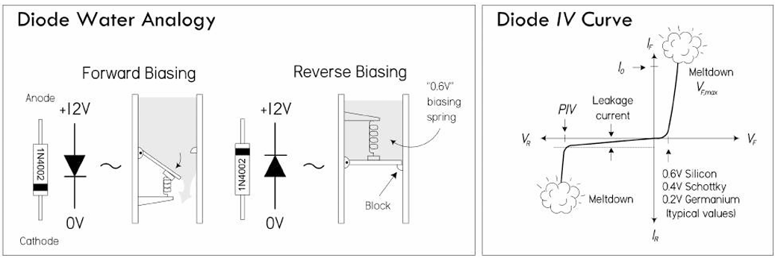
Water analogy

Slide 13





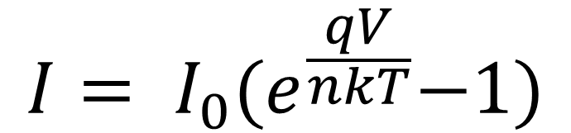













Diode Current Equation
$$I= I_{0}{(e}^{\frac{qV}{nkT}}−1)$$
This equation partially describes the behavior of a non-ideal diode

Slide 14
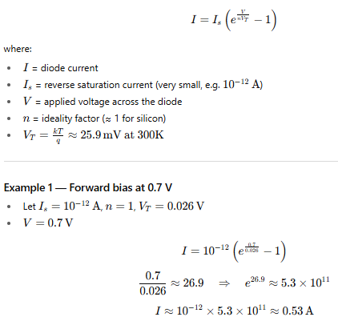










Diode Current Equation

Slide 15



Slide 16
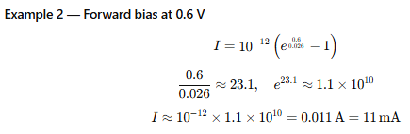
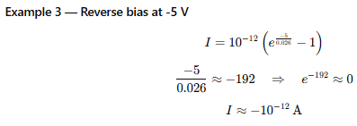
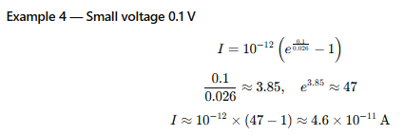
Diode Current Equation

Slide 17
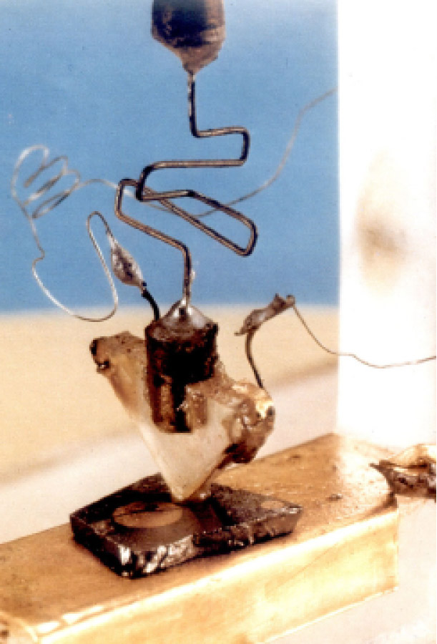


The First Transistor
December 16, 1947: John Bardeen and Walter Brattain successfully demonstrated the first working transistor at Bell Labs.
It was a point-contact transistor made of a small slab of germanium with two closely spaced gold contacts.
When input current was applied to one contact, it modulated the conductivity of the germanium, amplifying the signal seen at the other contact.
Key outcome: It could amplify electrical signals like a vacuum tube, but in a device only a few millimeters wide.
At Bell Telephone Laboratories, research was focused on finding a solid-state amplifier for telephone signal processing.
The three key scientists were:
John Bardeen (theorist)
Walter Brattain (experimentalist)
William Shockley (team leader, physicist)

Slide 18
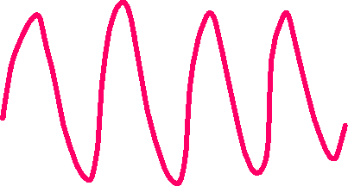





Transistor amplification

Slide 19
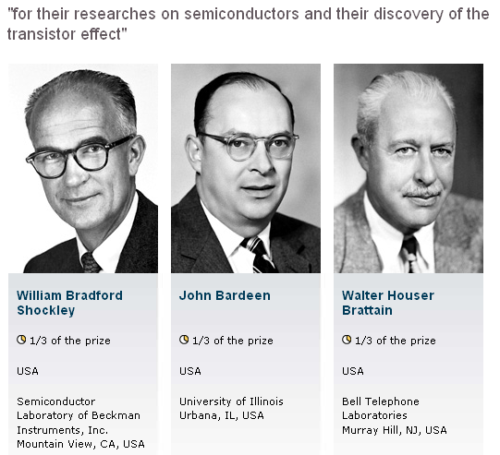
1956 Physics Nobel Prize

Slide 20
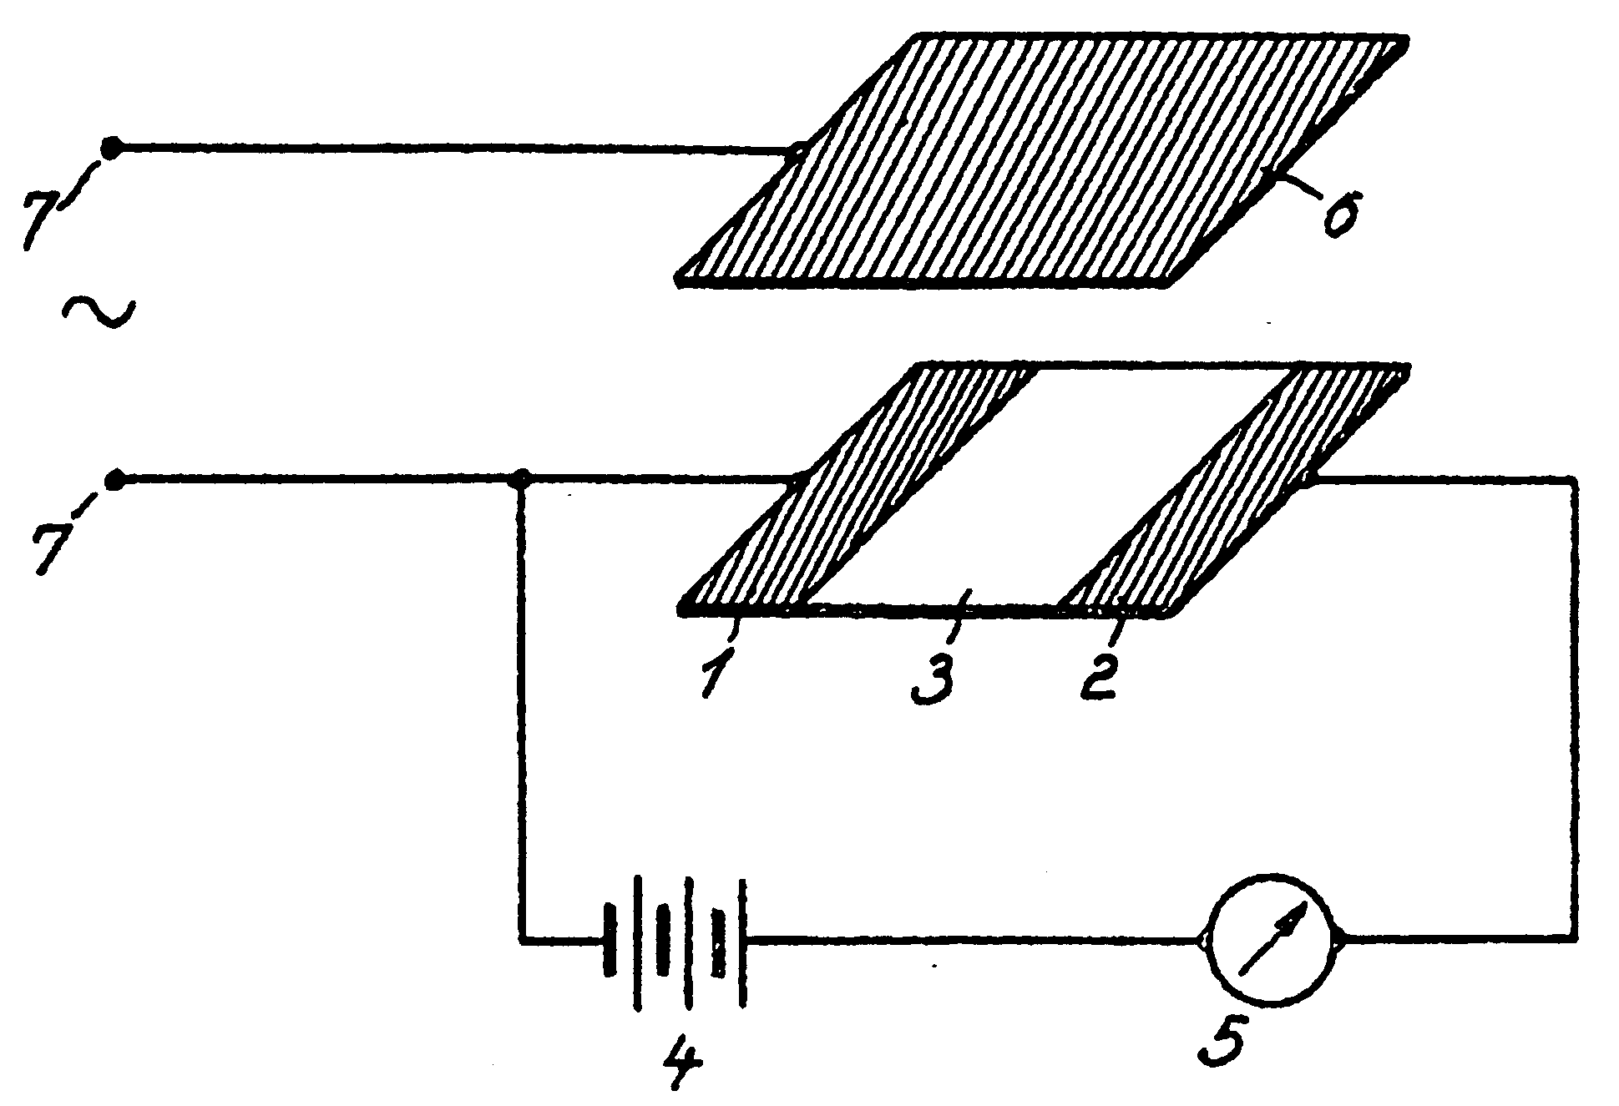
Invention of the Field-Effect Transistor
In 1935, a British patent was issued to Oskar Heil.
A working MOSFET was not demonstrated until 1955.

Slide 21















Slide 22






















Slide 23



















Slide 24
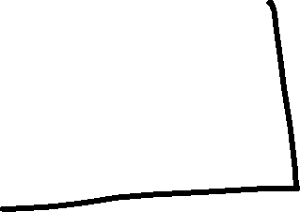
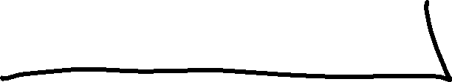





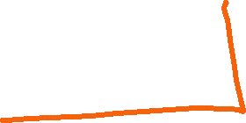










Slide 25
















Slide 26



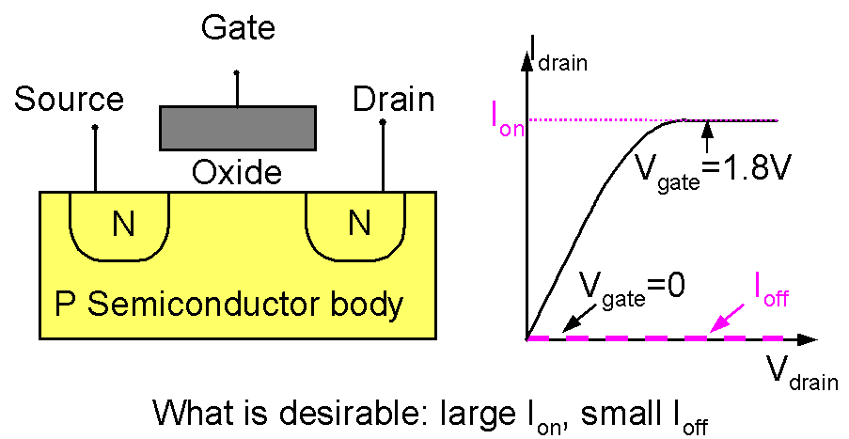
Introduction to the MOSFET
Basic MOSFET structure and IV characteristics

Slide 27





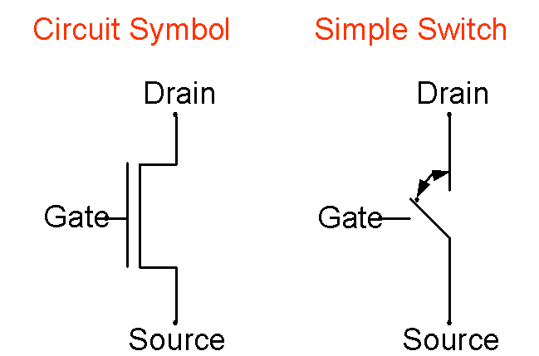









Introduction to the MOSFET
Two ways of representing a MOSFET:

Slide 28






Slide 29





Slide 30
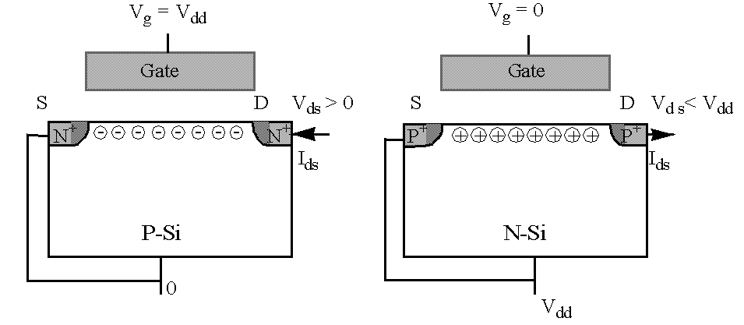
Complementary MOSFETs (CMOS)
NFET PFET
When V_{g} = V_{dd} , the NFET is on and the PFET is off.
When V_{g} = 0, the PFET is on and the NFET is off.

Slide 31
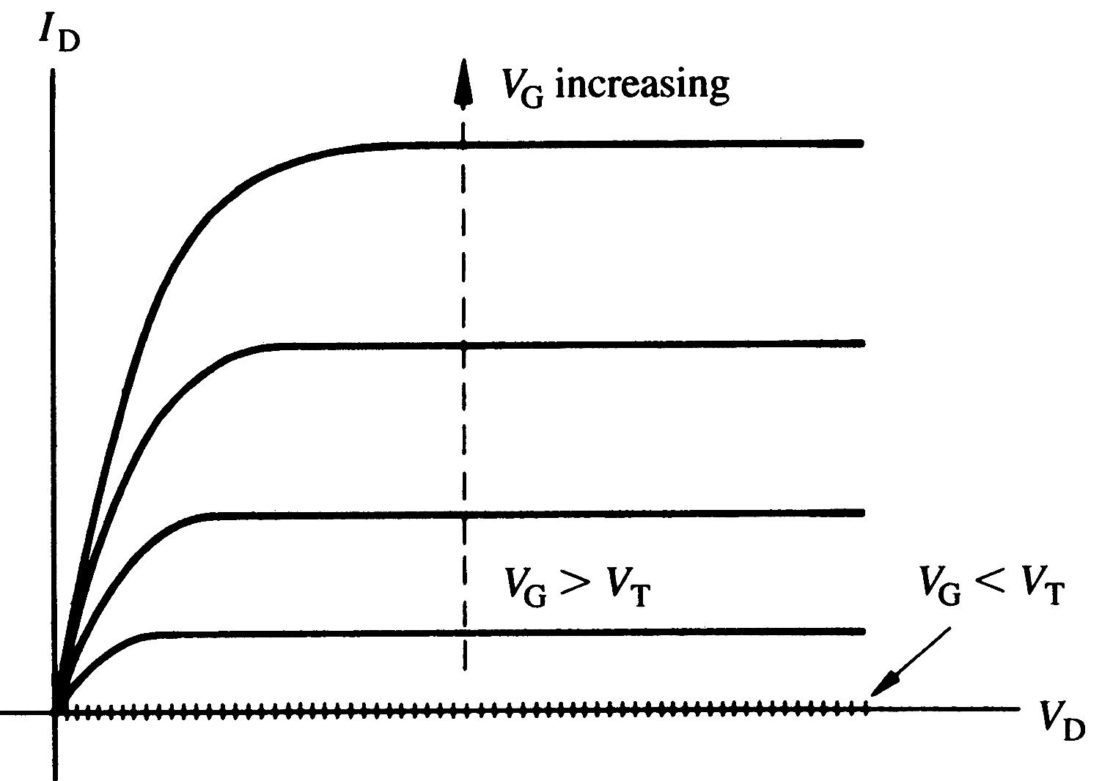














I_{D}-V_{DS} characteristics expected from a long channel (ΔL << L) MOSFET (n-channel), for various values of V_{G}

Slide 32
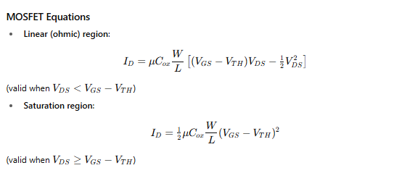
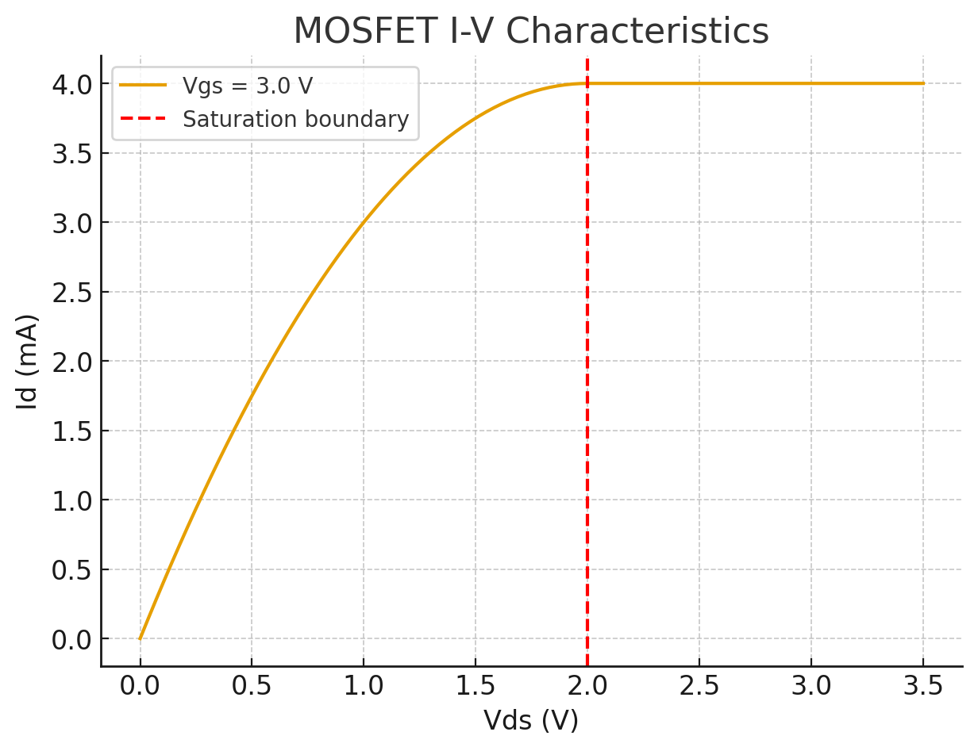
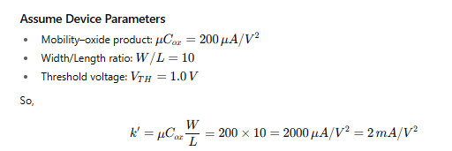















MOSFET current equations

Slide 33
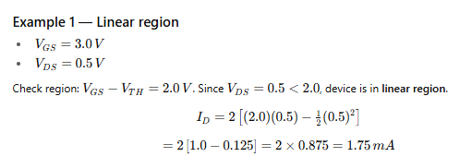


MOSFET current equations

Slide 34
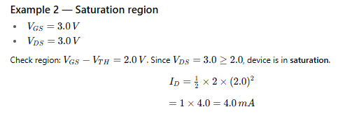


MOSFET current equations

Slide 35
CMOS (Complementary MOS) Inverter

Slide 36










CMOS (Complementary MOS) Inverter

Slide 37











CMOS (Complementary MOS) Inverter

Slide 38






CMOS (Complementary MOS) Inverter

Slide 39
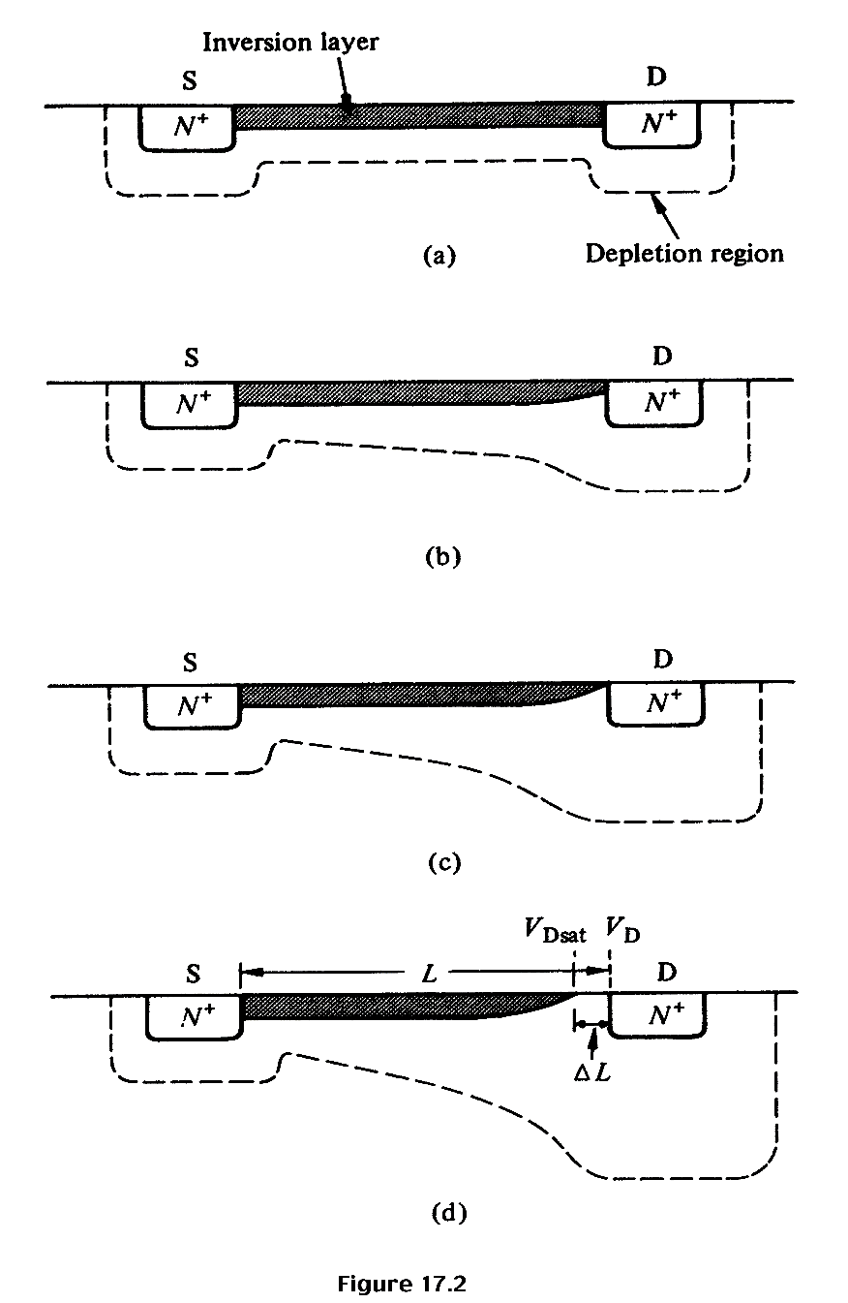














Qualitative discussion: n-MOSFET
V_{G} > V_{T} ; V_{DS} ≈ 0
I_{D} increases with V_{DS}
V_{G} > V_{T}; V_{DS} small, > 0
I_{D} increases with V_{DS} , but rate of increase decreases.
V_{G} > V_{T}; V_{DS} ≈ pinch-off
I_{D} reaches a saturation value, I_{D,sat} The V_{DS} value is called V_{DS,sat}
V_{G} > V_{T}; V_{DS} > V_{DS,sat}
I_{D} does not increase further, saturation region.

Slide 40




Quantitative I_{D}-V_{DS} Relationships – 1st attempt “Square Law”
;
I_{D} will increase as V_{DS} is increased, but when V_{G} – V_{DS} = V_{T}, pinch-off occurs, and current saturates when V_{DS} is increased further. This value of V_{DS} is called V_{DS,sat}. i.e., V_{DS,sat} = V_{G} – V_{T} and the current when V_{DS}= V_{DS,sat} is called I_{DS,sat}.
;
Here, C_{ox} is the oxide capacitance per unit area, C_{ox} = ε_{ox} / x_{ox}

Slide 41
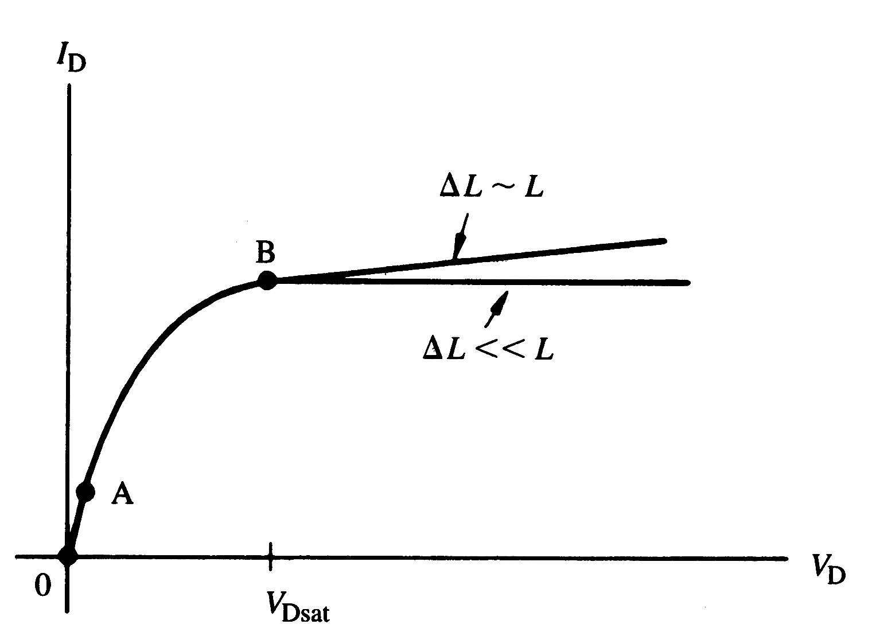
I_{D}-V_{DS} characteristics for n-MOSFET
Linear
region
Saturation
region

Slide 42
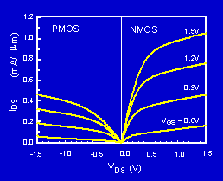
P-MOSFET N-MOSFET IV Characteristics
The PMOS IV is qualitatively similar to the NMOS IV, but the current is about half as large. Why?

Slide 43
Threshold and Subthreshold

Slide 44
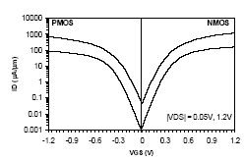
Subthreshold Current
The leakage current that flows at V_{g}<V_{t} is called the subthreshold current. Previously we had assumed that current is zero, but in reality that’s not the case.
)
m
μ
Intel, T. Ghani et al., IEDM 2003
/
90nm technology. Gate length: 45nm for NMOS, 50nm for PMOS
A
μ
(
s
I
d
V_{gs}
The current at V_{gs}=0 and V_{ds}=V_{dd} is called I_{off.}

